Slide 1
Why polymer theory is beautiful (and why you should care)
Takashi Yokokura
CBE Student Colloquium
04/27/2023

Slide 2

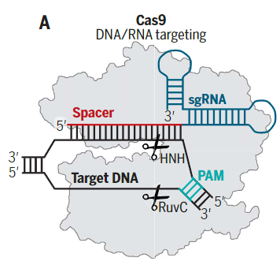
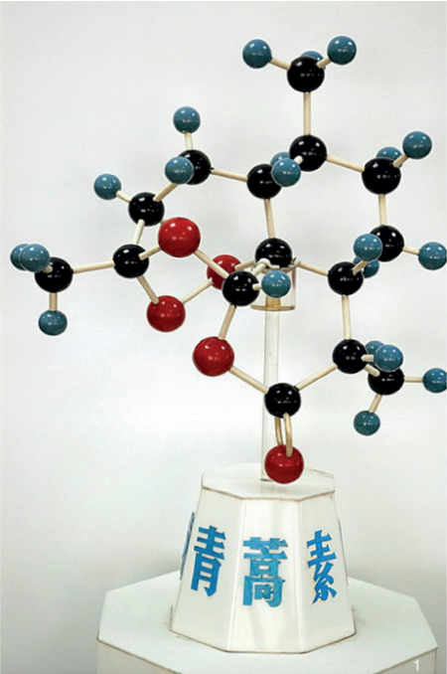
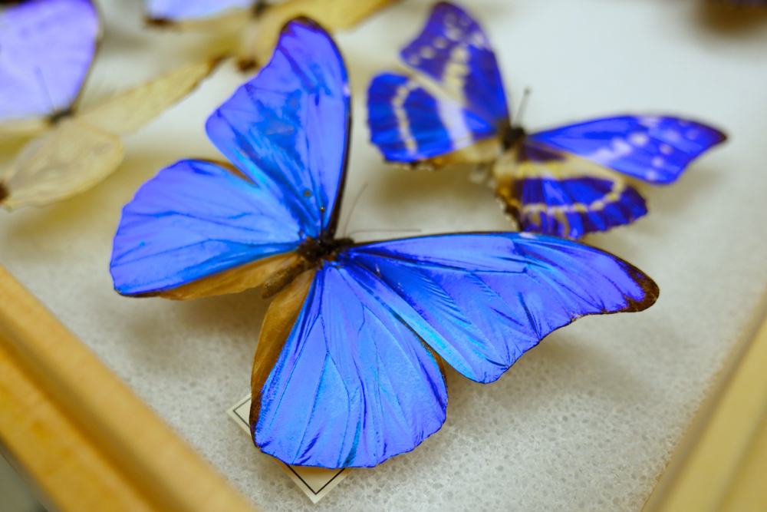

What is beauty (in physics)?
Before today:
Traditional beauty and its underlying mechanisms
Triumphs in molecular discovery and application
Artemisinin
https://www.kqed.org/science/24552/what-gives-the-morpho-butterfly-its-magnificent-blue
Knott, Doudna. (2018). Science. 361 (6405)
Tu. (2016). Angew. Chem. Int. Ed. 55
After today:
Abstracting complex phenomena into mathematical models
Better understanding of the world around us
Systematic approach to solving engineering problems

Slide 3


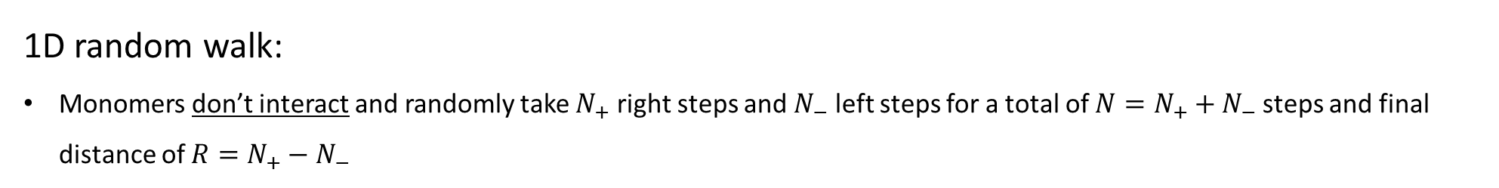

The (beautiful?) math of polymers
1D random walk:
Monomers don’t interact and randomly take $N_{+}$ right steps and $N_{−}$ left steps for a total of $N=N_{+}+N_{−}$ steps and final distance of $R=N_{+}−N_{−}$
2
5
6
1
0
3
4
7
$$R= 5 −2=3$$
Total number of trajectories (possible polymers) for a given $N$ and $R$:

Slide 4
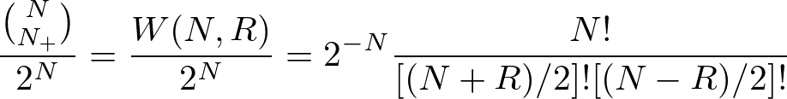
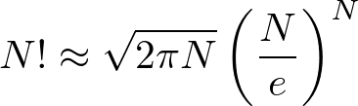
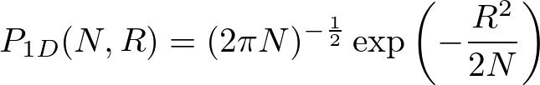
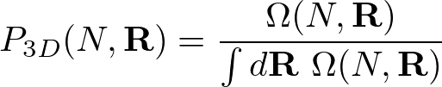

The (beautiful?) math of polymers
Probability
Total number of trajectories (possible polymers) for a given $N$ and $R$:
Algebra
Stirling’s formula:
Only non-zero $W(N,R)$’s (Divide by 2)
Entropy

Slide 5

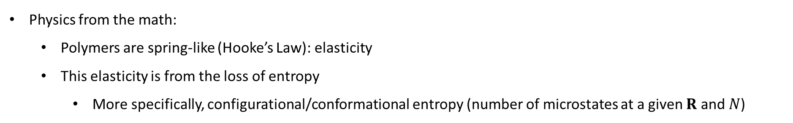
The (beautiful?) math of polymers
Entropy
Free Energy (Helmholtz)
(Monomers non-interacting)
Physics from the math:
Polymers are spring-like (Hooke’s Law): elasticity
This elasticity is from the loss of entropy
More specifically, configurational/conformational entropy (number of microstates at a given $R$ and $N$)
R
R
R
R
R
R
Elastic penalty

Slide 6
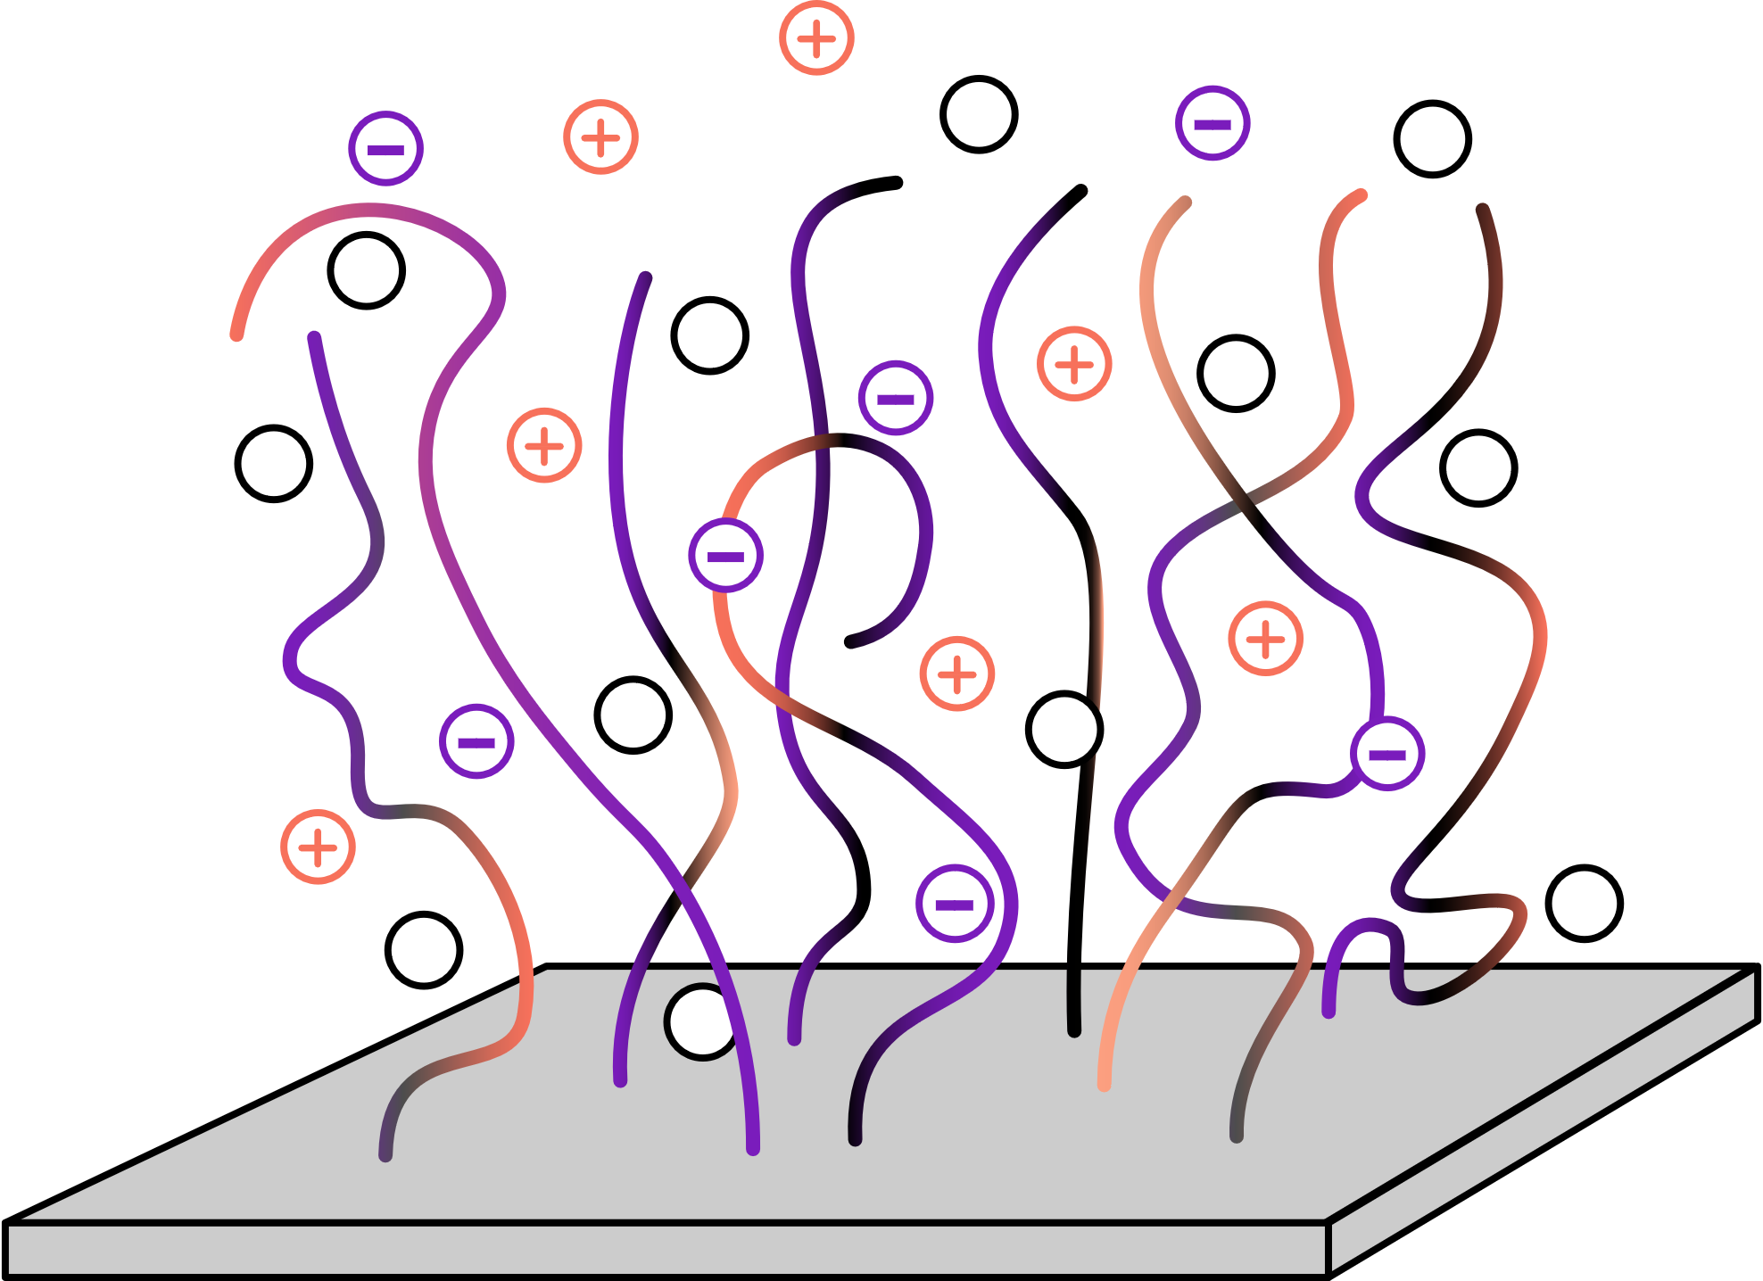
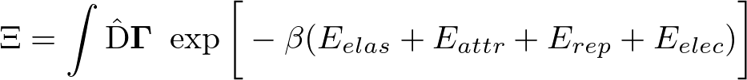
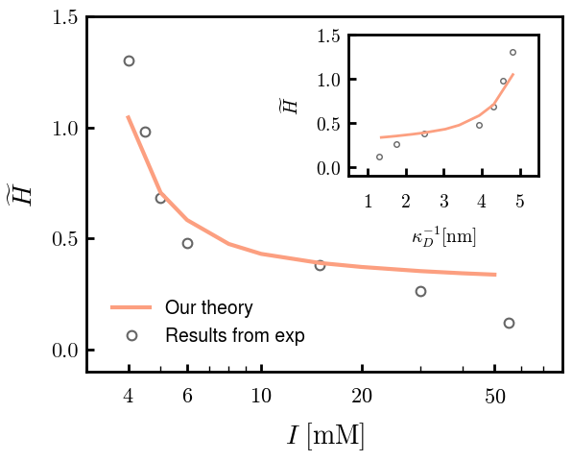
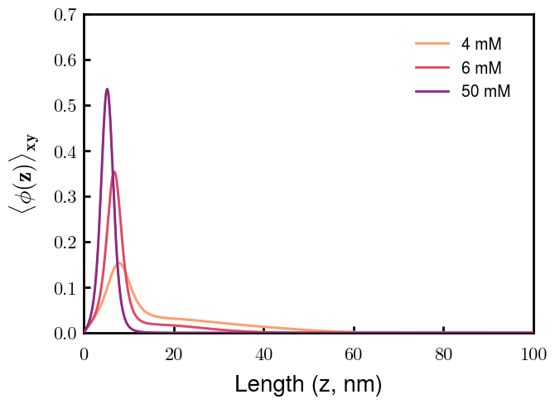
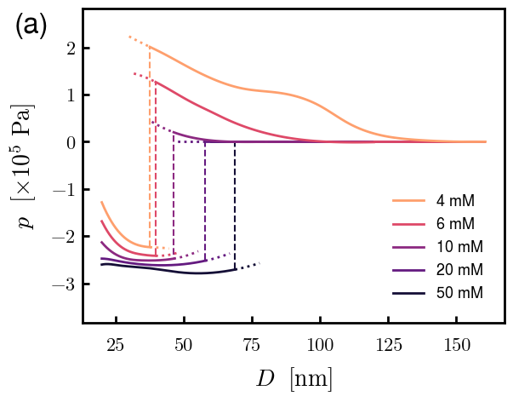
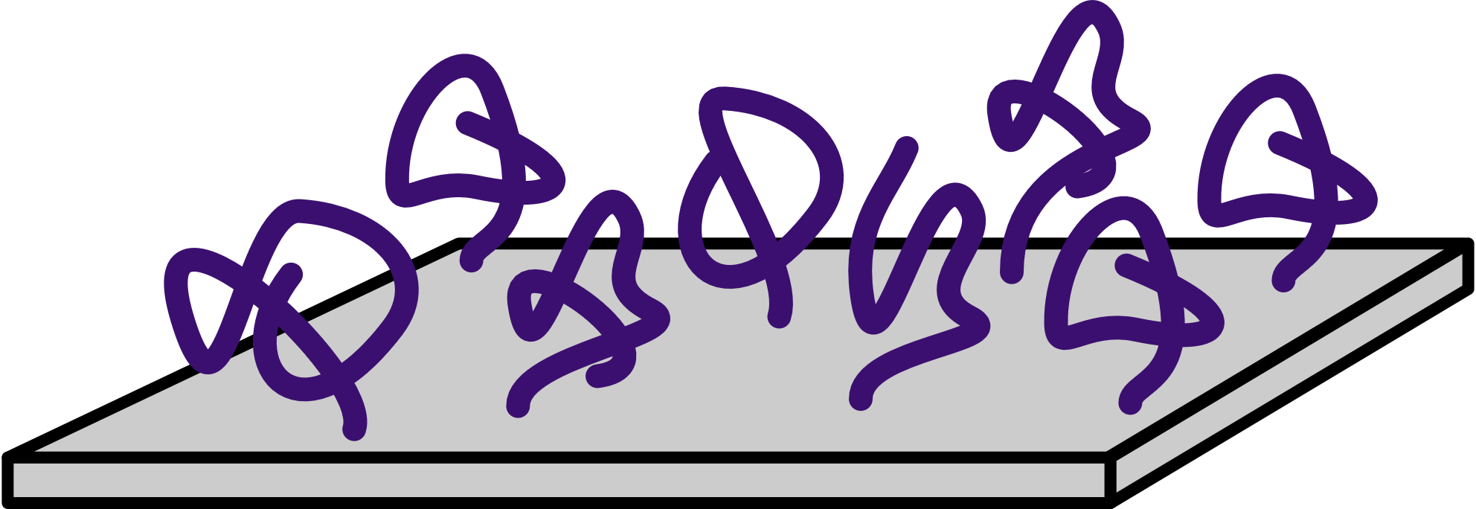
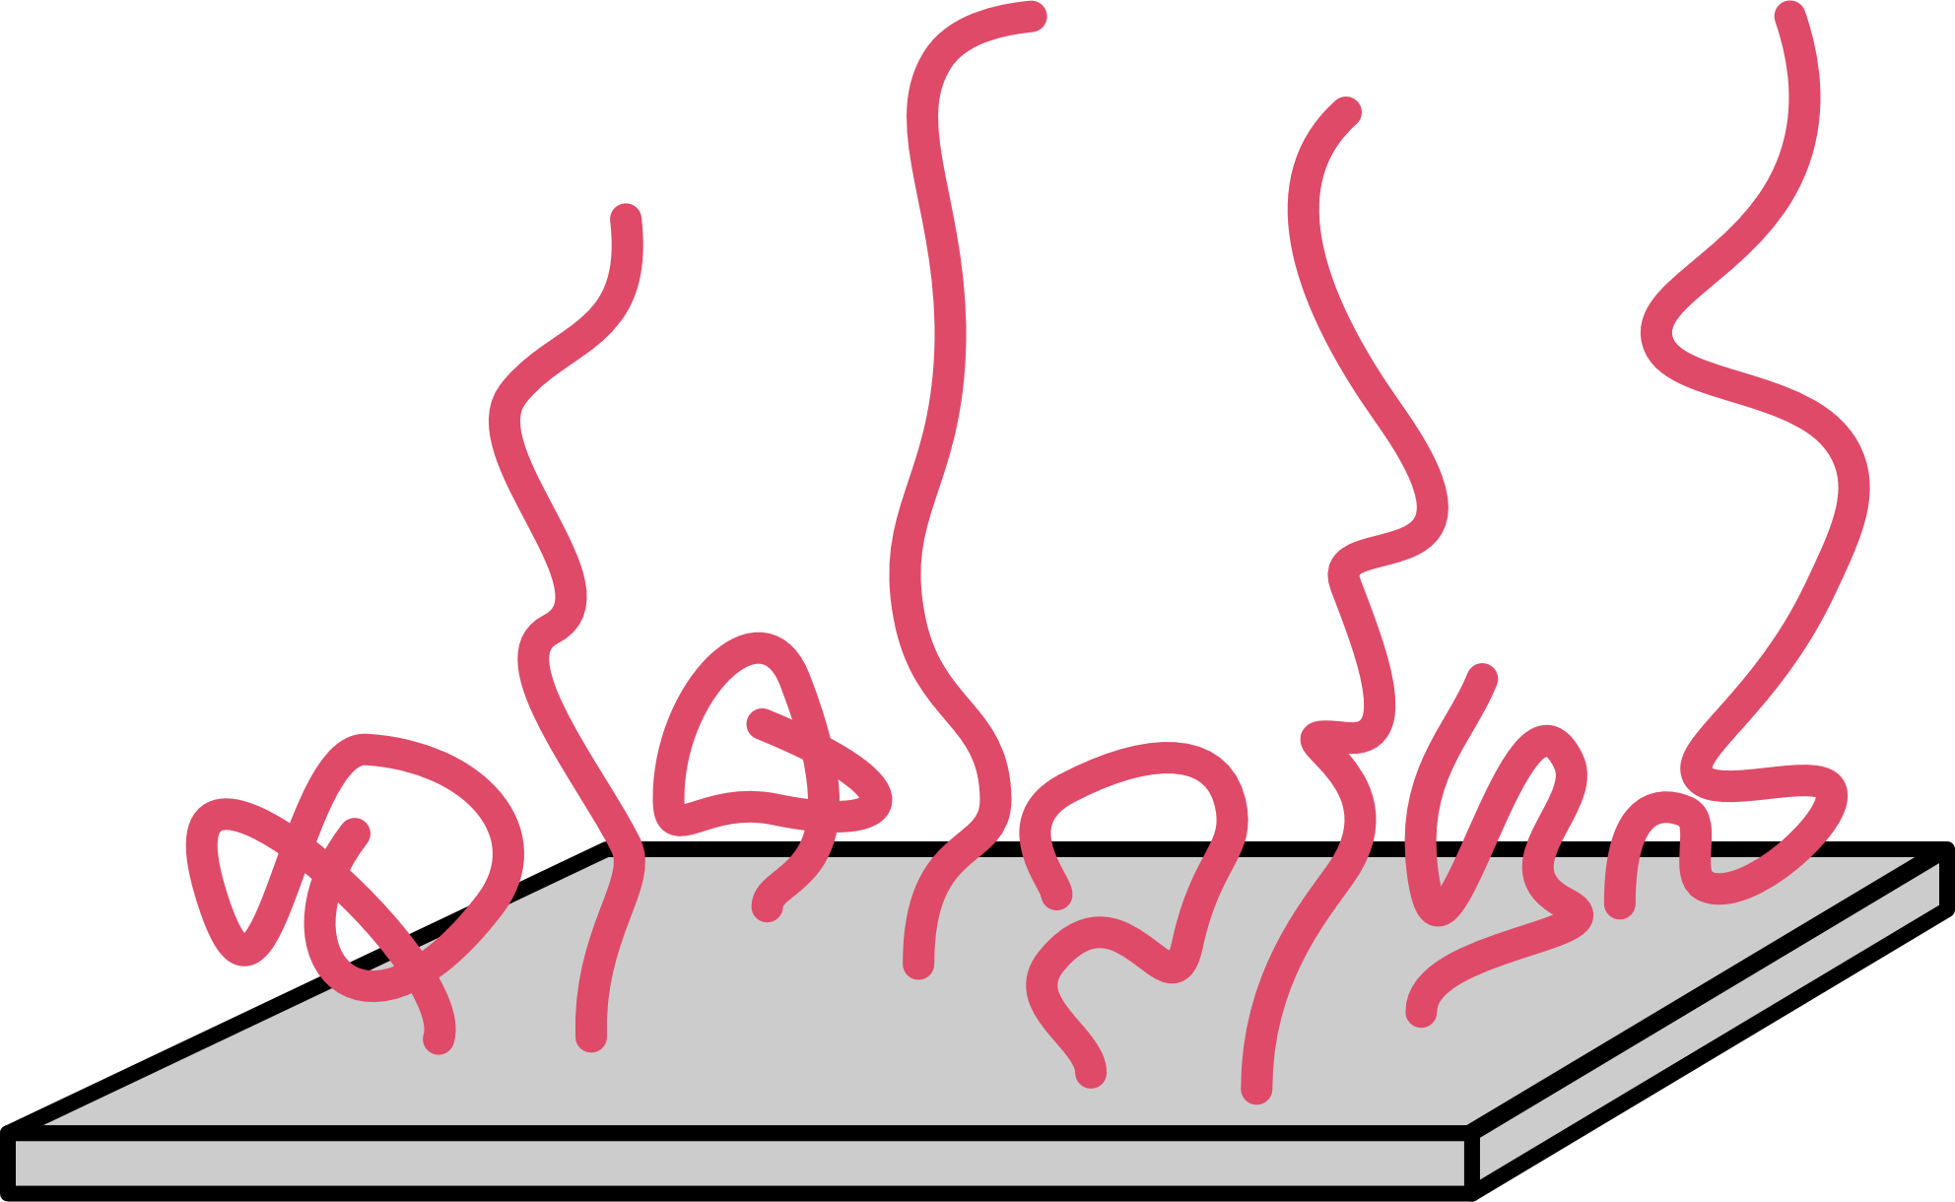
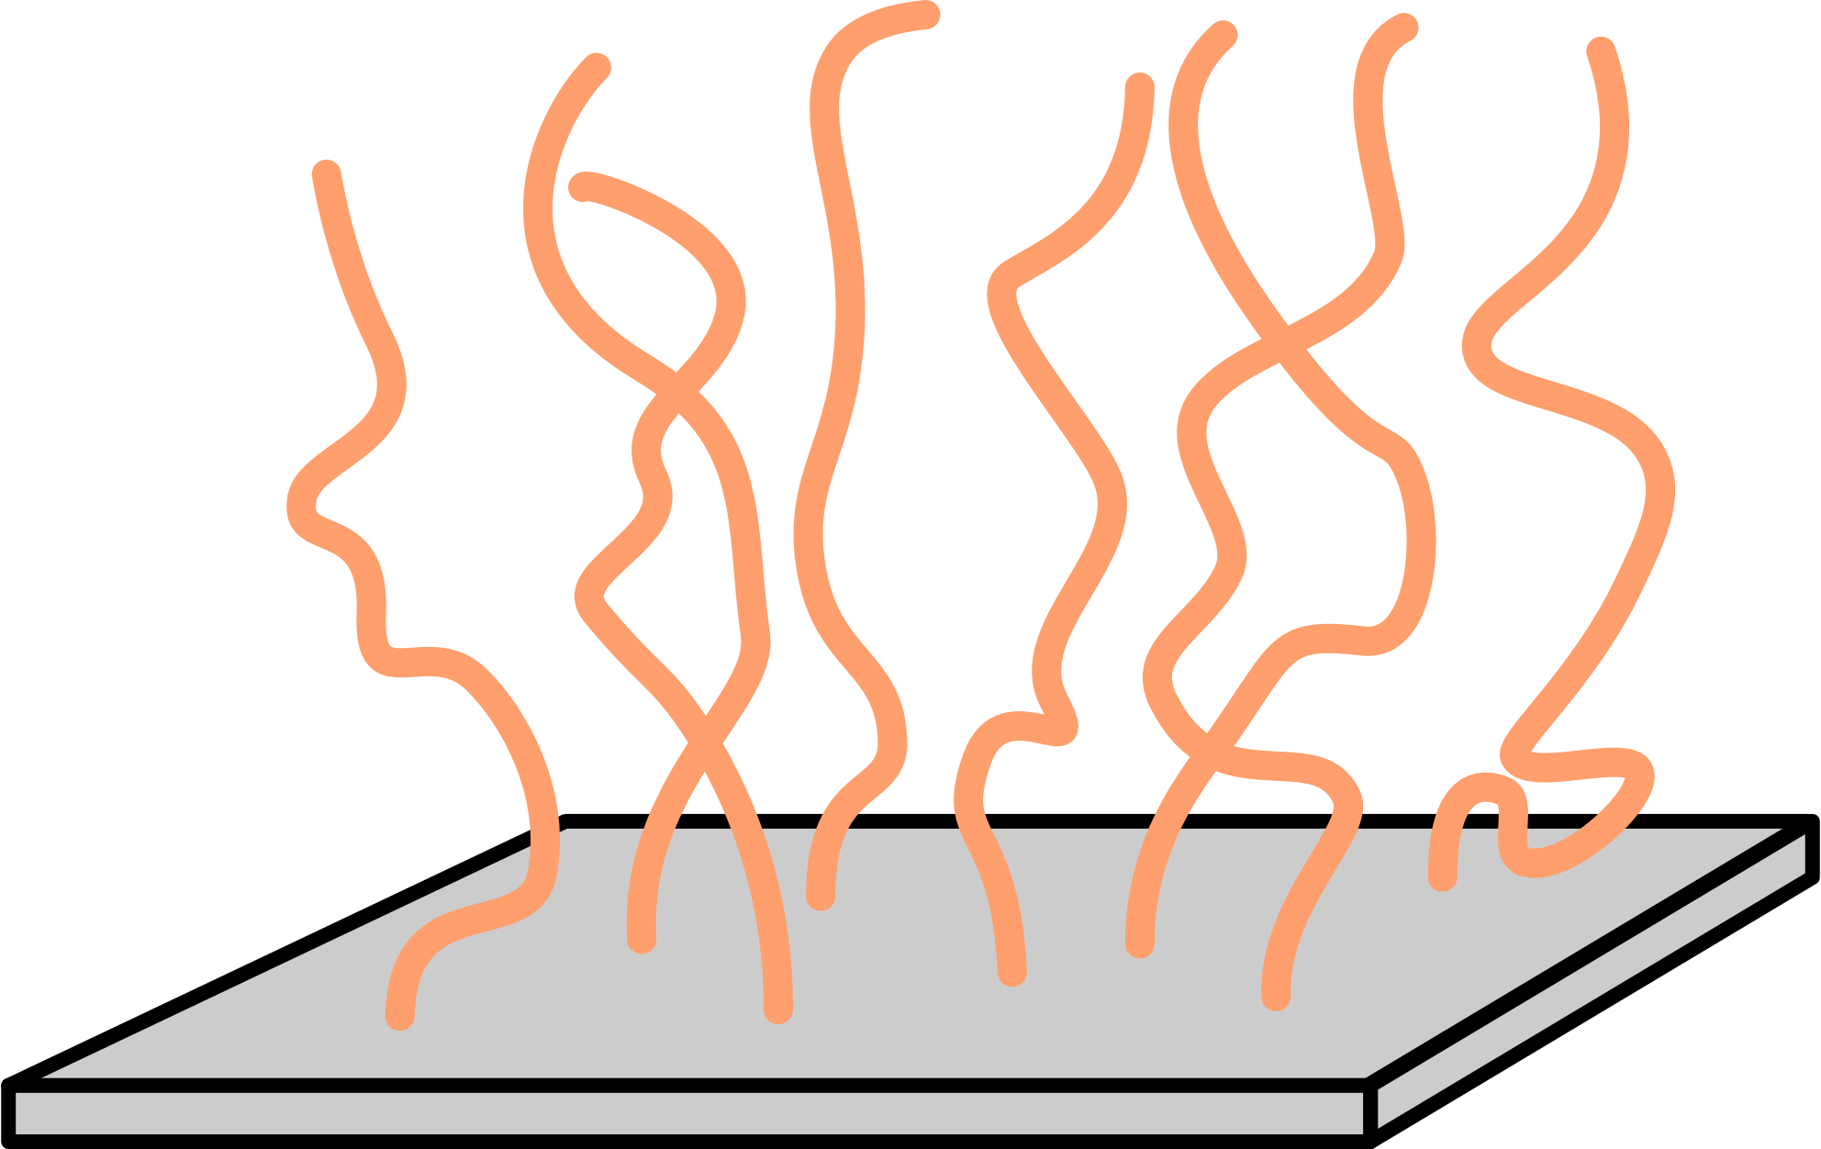
With a little more sophistication, theory can be a powerful, relevant tool
Gaussian chain
Flory-Huggins
Incompressibility
Electrostatics
Self-consistent field theory (SCFT)
Polymer morphologies (density profiles)
Phase transitions (free energies)
Much more!
Experimental comparison
Polymer organization
Spectra predictions
I
More importantly,

Slide 7
Other (beautiful?) applications of our theory
Vesicle fission by topology
Aggregation
Something about NLH?

Slide 8
Thank you!

Slide 9
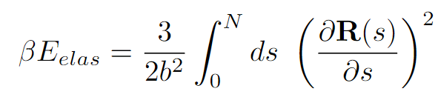
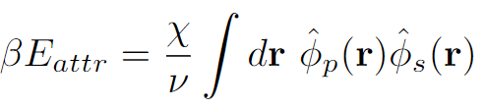
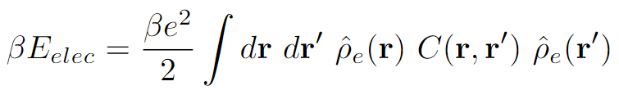

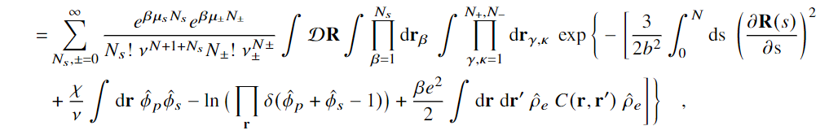
Partition Function Formulation
+
s
s
-
Elastic entropy following Gaussian statistics
+
-
+
s
s
Flory-Huggins short-range interactions
s
-
+
+
+
+
+
+
+
+
+
s
-
s
+
Electrostatic correlations
-
+
s
s
-
Local incompressibility
s
+
+
s

Slide 10

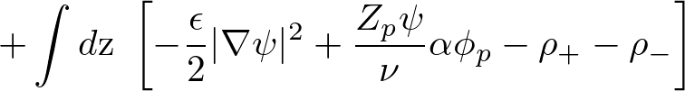

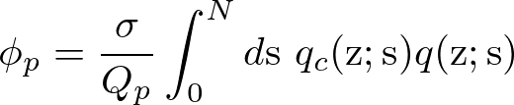
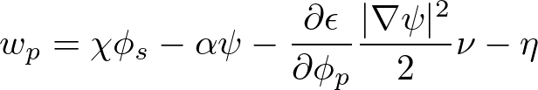
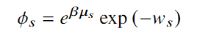


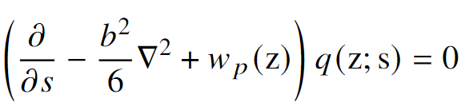
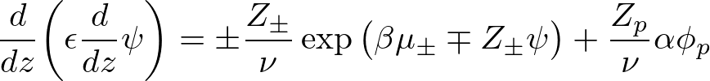



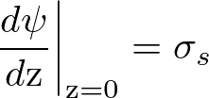

Free Energy and SCF Equations
Free Energy (ensemble average across surface)
Functional Minimization
Polymer Density:
Polymer-controlling Field:
Solvent Density:
Solvent-controlling Field:
Incompressibility:
Monomer Probability:
Electrostatic Potential:

